Slide 1
Customer Churn Analysis
Executive Insight Deck Prepared by: Llinvile de Jongh

Slide 2
Business Objective
The purpose of this analysis is to:
Identify key customer behaviours that lead to churn
Understand which usage and revenue patterns signal early churn risk
Provide actionable insights to reduce churn and protect revenue
Business Question Answered:
Which customer behaviours should the business act on early to prevent customer loss?

Slide 3
Key Insights (What the Data Revealed)
Usage is the strongest churn signal
Customers who churn consistently show lower call minutes and call volumes
Declining usage is an early warning indicator, not a last-minute signal
Low-value customers churn more frequently
Churned customers generate significantly lower charges
Lower spend reflects lower perceived value and engagement
Engagement drives loyalty
Customers with international usage and feature adoption are more likely to stay
Engagement breadth matters more than raw call frequency

Slide 4
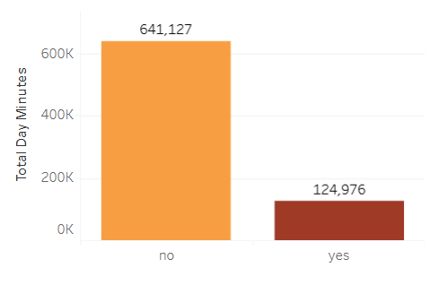
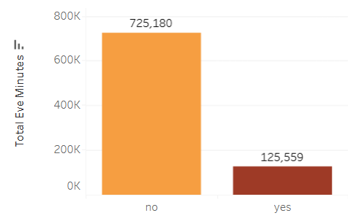
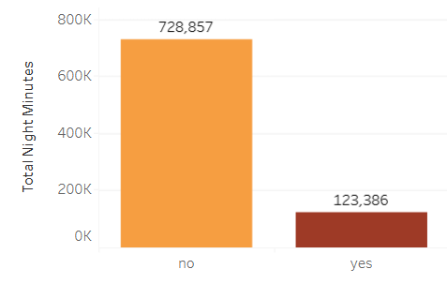
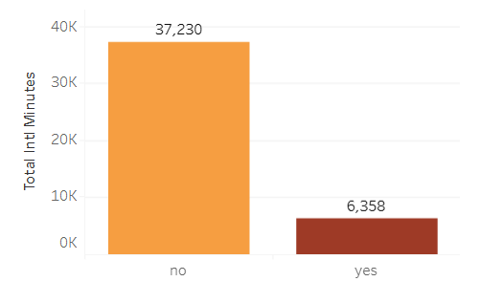
Visual Insight: Usage vs Churn
Churn by Daily Minutes
Churn by Evening Minutes
Churn by Night Minutes
Executive Interpretation
Non-churn customers consistently use the service more across all time periods
Churn is strongly linked to under-utilisation, not service overload
Why This Matters
The business can detect churn months earlier by monitoring usage decline
Retention strategies should trigger before usage reaches low levels
Churn by International Minutes

Slide 5
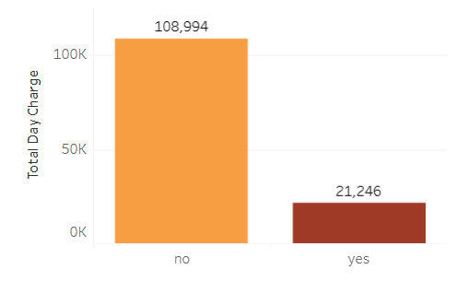
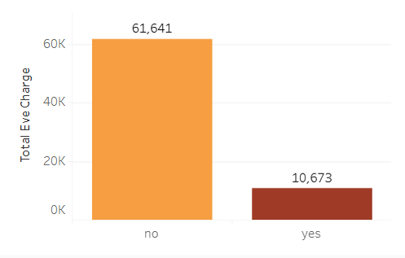
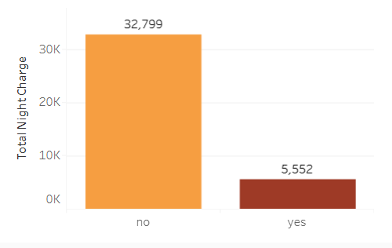
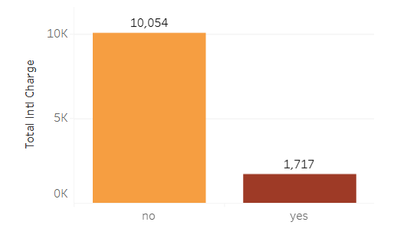
Visual Insight: Charges & Value Perception
Churn by Daily Charges
Churn by Evening Charges
Churn by Night Charges
Churn by International Charges
Executive Interpretation
Customers with higher charges are less likely to churn
Low charges indicate weak product value perception
Why This Matters
Churn is not driven by price pressure alone
It is driven by lack of perceived value

Slide 6
Churn Risk KPI Profile (Executive Summary)
EXECUTIVE INTERPRETATION (This Is the Value)
What Defines a Churn-Risk Customer
Churned customers show consistently lower usage across all time periods
Lower usage translates directly into lower revenue contribution
Churn risk is linked to low engagement and weak value perception, not excessive cost
Business Interpretation
Customers disengage before they churn. Declining usage is an early and measurable warning signal.
Customer Usage & Value KPIs
KPI | Average Value
Average Minutes per Day | 180.3
Average Minutes per Evening | 200.2
Average Minutes per Night | 200.5
Average Calls per Day | 99.9
Average International Minutes | 10.3
Average Daily Charges | 30.6
Average Evening Charges | 17.0
Average Night Charges | 9.0

Slide 7
Recommendations (What the Business Should Do)
Early-Warning Churn Monitoring
Track usage drops as the primary churn signal
Flag customers whose usage declines over consecutive periods
Proactive Retention Campaigns
Target low-usage, low-charge customers early
Introduce usage-based incentives or engagement nudges
Increase Feature Adoption
Encourage international usage and service add-ons
Use onboarding and education to deepen engagement

Slide 8
Expected Business Impact (Why This Matters Financially)
Projected Impact
5–10% reduction in churn through early intervention
Improved customer lifetime value
Lower cost of retention compared to customer acquisition
Strategic Value
Enables data-driven retention strategy
Improves revenue predictability
Aligns analytics directly with business outcomes

